Slide 1
EPR protocol (E91)
Ekert, 1991
2/10/2021

Slide 2
Spin

Slide 3
Superposition

Slide 4
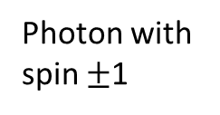
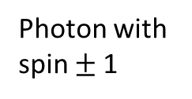
EPR Pradox (Einstein, Podolsky và Rosen, 1935)
1120 km, 2020
Photon with spin $±$1
Photon with spin $±$1
Crystal
High energy photon

Slide 5
EPR Pradox: when measure
“Spooky action”
Photon with spin 1
Crystal
High energy photon

Slide 6
EPR Pradox: when measure
“Spooky action”
Photon with spin -1
Photon with spin 1
Crystal
High energy photon

Slide 7
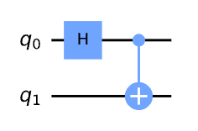
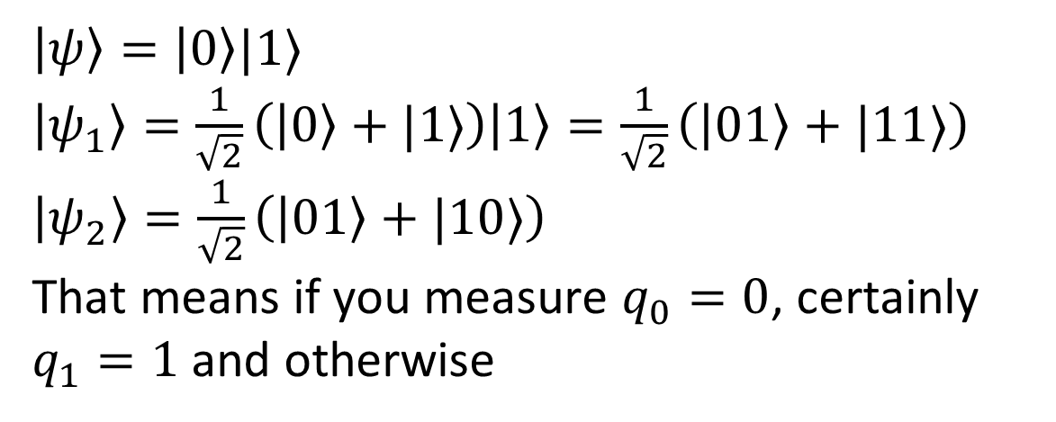
Entangled state
X
$\left|ψ\right\rangle =\left|0\right\rangle |1⟩$
$\left|ψ_{1}\right\rangle =\frac{1}{\sqrt{2}}\left(\left|0\right\rangle +|1⟩\right)\left|1\right\rangle =\frac{1}{\sqrt{2}}\left(\left|01\right\rangle +|11⟩\right)$
$\left|ψ_{2}\right\rangle =\frac{1}{\sqrt{2}}\left(\left|01\right\rangle +|10⟩\right)$
That means if you measure $q_{0}=0$, certainly $q_{1}=1$ and otherwise

Slide 8
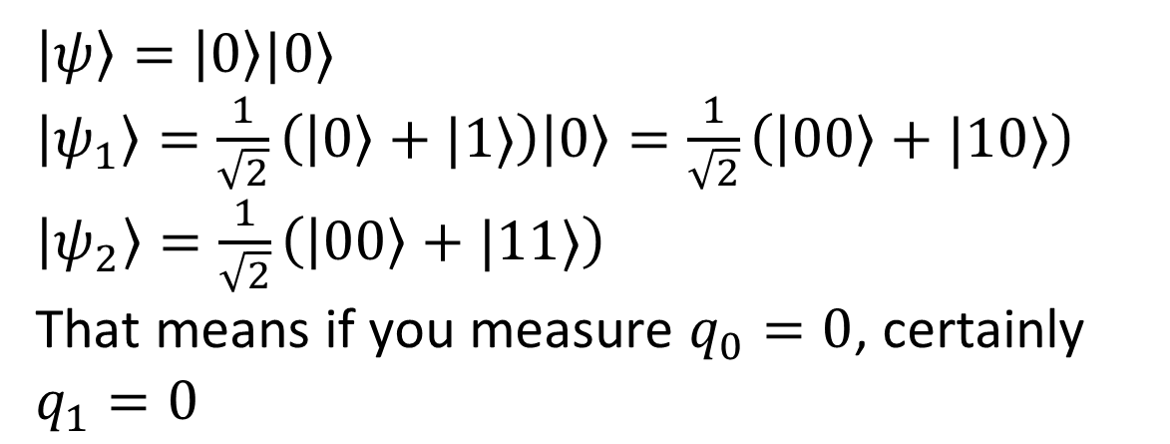
Entangled state
$\left|ψ\right\rangle =\left|0\right\rangle |0⟩$
$\left|ψ_{1}\right\rangle =\frac{1}{\sqrt{2}}\left(\left|0\right\rangle +|1⟩\right)\left|0\right\rangle =\frac{1}{\sqrt{2}}\left(\left|00\right\rangle +|10⟩\right)$
$\left|ψ_{2}\right\rangle =\frac{1}{\sqrt{2}}\left(\left|00\right\rangle +|11⟩\right)$
That means if you measure $q_{0}=0$, certainly $q_{1}=0$

Slide 9
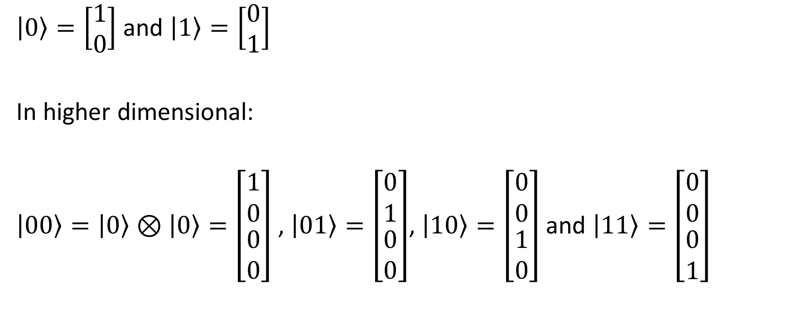
Classical basis
$\left|0\right\rangle =\left[\begin{matrix}1 \\ 0\end{matrix}\right]$ and $\left|1\right\rangle =\left[\begin{matrix}0 \\ 1\end{matrix}\right]$
In higher dimensional:
$\left|00\right\rangle =\left|0\right\rangle ⊗\left|0\right\rangle =\left[\begin{matrix}1 \\ 0 \\ \begin{matrix}0 \\ 0\end{matrix}\end{matrix}\right]$ , $\left|01\right\rangle =\left[\begin{matrix}0 \\ 1 \\ \begin{matrix}0 \\ 0\end{matrix}\end{matrix}\right]$, $\left|10\right\rangle =\left[\begin{matrix}0 \\ 0 \\ \begin{matrix}1 \\ 0\end{matrix}\end{matrix}\right]$ and $\left|11\right\rangle =\left[\begin{matrix}0 \\ 0 \\ \begin{matrix}0 \\ 1\end{matrix}\end{matrix}\right]$

Slide 10

Bell basis
$$\left|Ψ^{+}\right\rangle =\frac{1}{\sqrt{2}}\left(\left|01\right\rangle +|10⟩\right)$$
$$\left|Ψ^{−}\right\rangle =\frac{1}{\sqrt{2}}\left(\left|01\right\rangle −|10⟩\right)$$
$$\left|Φ^{+}\right\rangle =\frac{1}{\sqrt{2}}\left(\left|00\right\rangle +|11⟩\right)$$
$$\left|Φ^{−}\right\rangle =\frac{1}{\sqrt{2}}\left(\left|00\right\rangle −|11⟩\right)$$

Slide 11
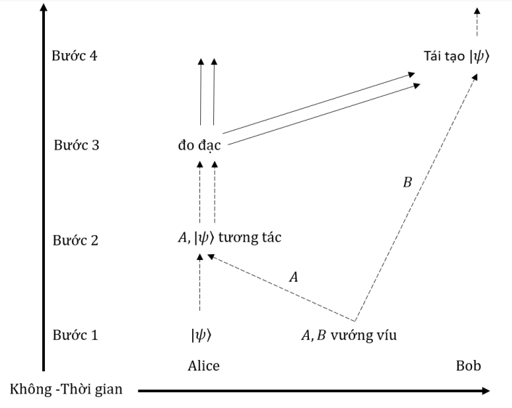
EPR protocol

Slide 12
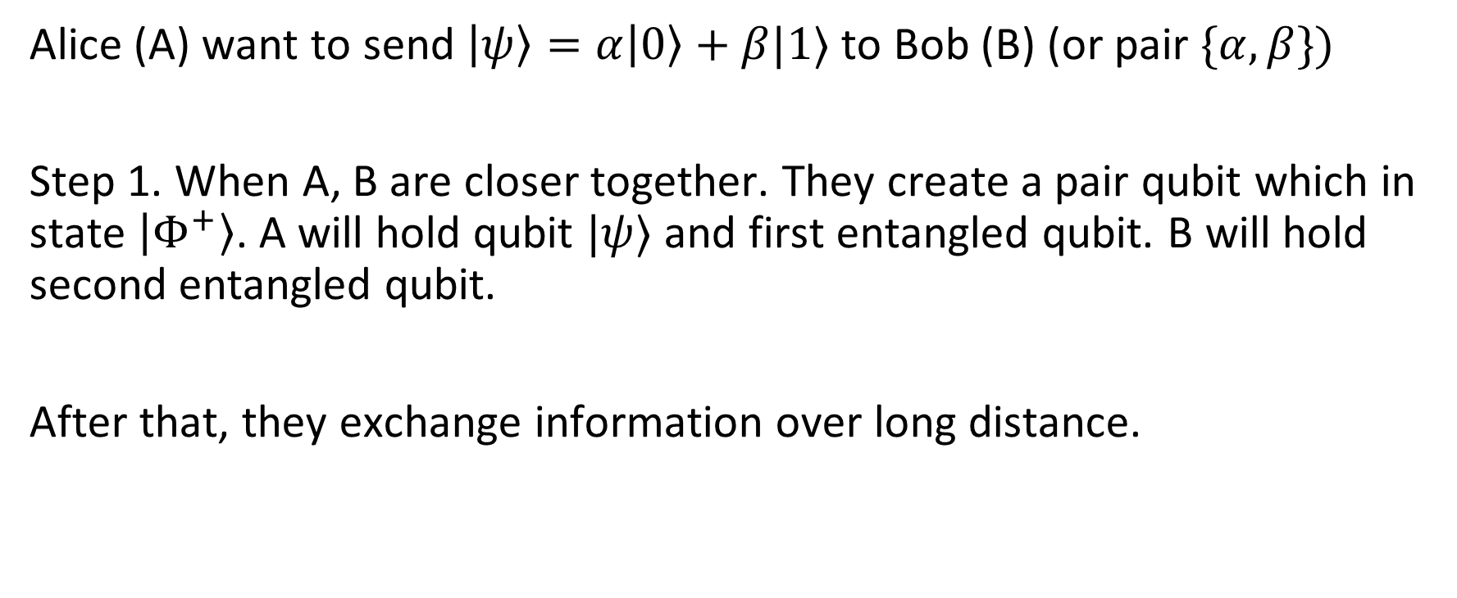
EPR protocol
Alice (A) want to send $\left|ψ\right\rangle =α\left|0\right\rangle +β|1⟩$ to Bob (B) (or pair $\{α,β\})$
Step 1. When A, B are closer together. They create a pair qubit which in state $\left|Φ^{+}\right\rangle$. A will hold qubit $|ψ⟩$ and first entangled qubit. B will hold second entangled qubit.
After that, they exchange information over long distance.

Slide 13
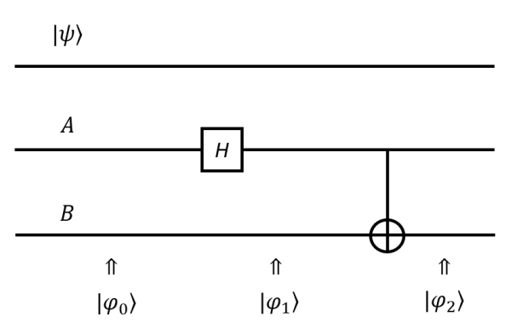
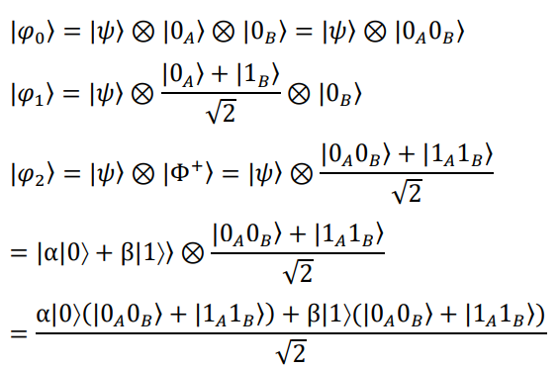
EPR protocol: Step 1

Slide 14

EPR protocol
Step 2. To begin exchange information, A lets $|ψ⟩$ interact with the first entangled qubit.

Slide 15
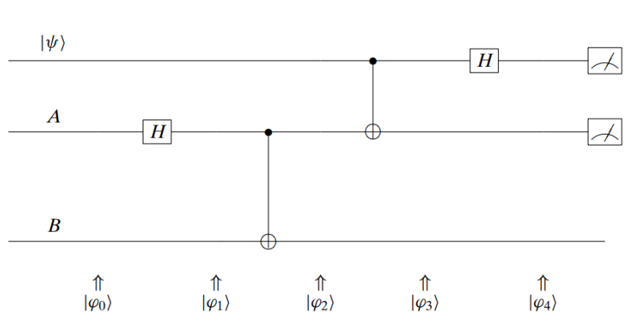
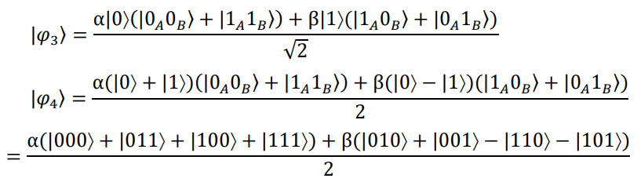
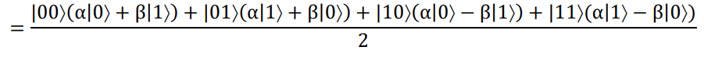
EPR protocol: Step 2
Superposition of 4 states.
Note that two first qubit is in Alice’s possession

Slide 16
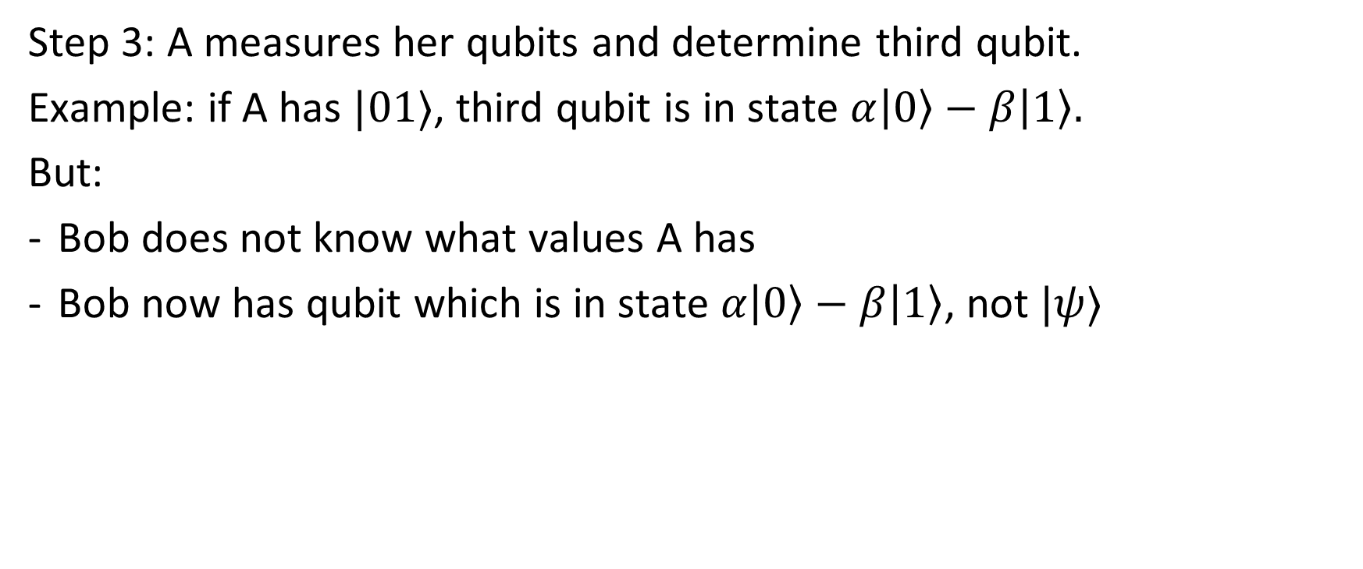
EPR protocol: Step 3
Step 3: A measures her qubits and determine third qubit.
Example: if A has $|01⟩$, third qubit is in state $α\left|0\right\rangle −β\left|1\right\rangle .$
But:
Bob does not know what values A has
Bob now has qubit which is in state $α\left|0\right\rangle −β\left|1\right\rangle$, not $|ψ⟩$

Slide 17
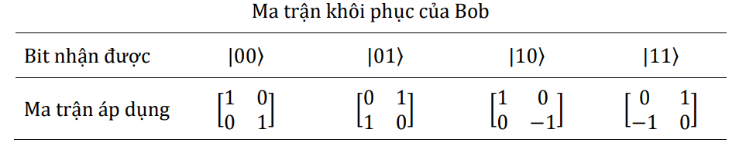
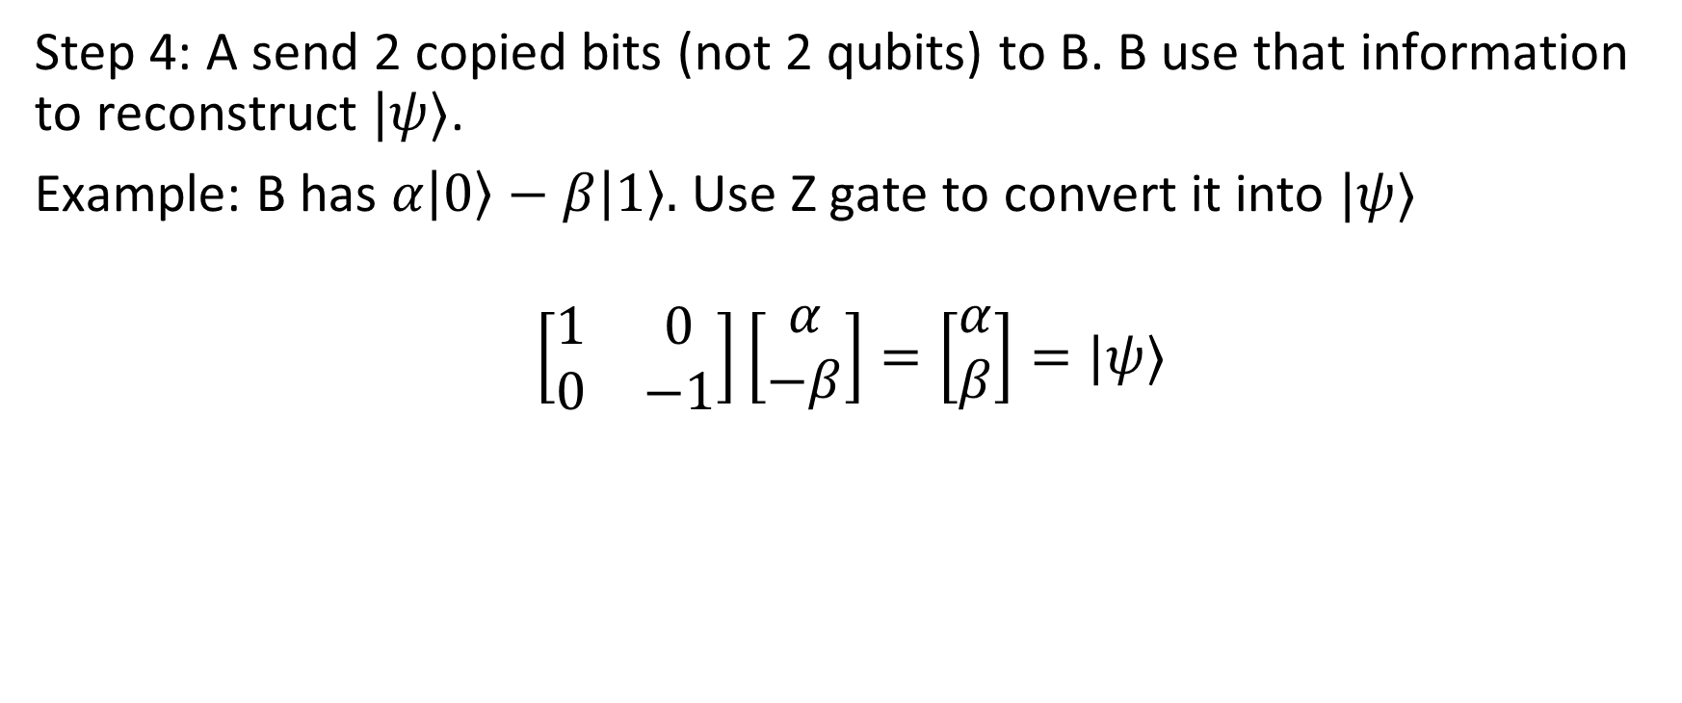
EPR protocol: Step 4
Step 4: A send 2 copied bits (not 2 qubits) to B. B use that information to reconstruct $|ψ⟩$.
Example: B has $α\left|0\right\rangle −β\left|1\right\rangle .$ Use Z gate to convert it into $|ψ⟩$
$$\left[\begin{matrix}1 & 0 \\ 0 & −1\end{matrix}\right]\left[\begin{matrix}α \\ −β\end{matrix}\right]=\left[\begin{matrix}α \\ β\end{matrix}\right]=|ψ⟩$$

Slide 18
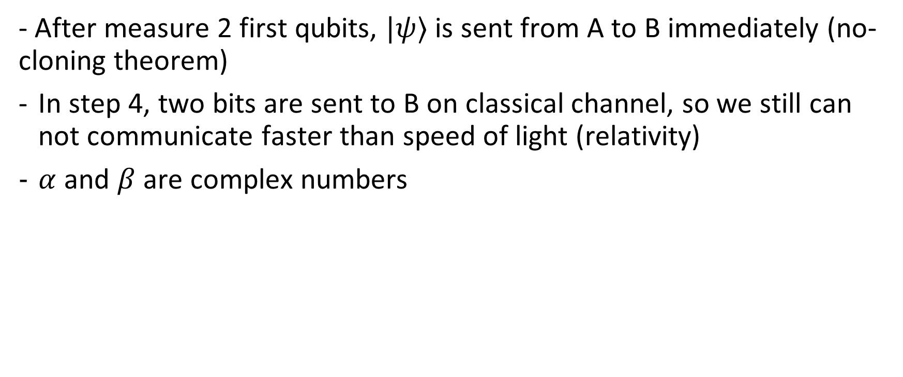
Summary
- After measure 2 first qubits, $|ψ⟩$ is sent from A to B immediately (no-cloning theorem)
In step 4, two bits are sent to B on classical channel, so we still can not communicate faster than speed of light (relativity)
$α$ and $β$ are complex numbers

